Slide 1

Predicting Tanzanian Water Pump Maintenance Needs
Oswald Aguiar
P392010001
5th August, 2021
Guide - Mr. Saurabh Agarwal

Slide 2
Contents
The Dataset and associated Challenges
Methodology
Exploratory Data Analysis
Data Transformation and Feature Engineering
Feature Extraction
Building and Training a Model
Hyperparameter Tuning
Model Comparison and Evaluation
Model Interpretability
Project Findings
Conclusions
Learning Points
References

Slide 3
Declaration
I the undersigned solemnly declare that the project report PREDICTING TANZANIA WATER PUMP MAINTENANCE NEEDS is based on my own work. I assert the statements made and conclusions drawn are an outcome of my research work. I further certify that
The work contained in the report is original and has been done by me.
The work has not been submitted to any other Institution for any other degree/diploma/certificate in this university or any other University of India or abroad.
I have followed the guidelines provided by AIMA in writing this report.
Whenever I have used materials (data, theoretical analysis, and text) from other sources, we have given due credit to them in the text of the report and giving their details in the references.
Oswald Aguiar
P392010001
5th August, 2021

Slide 4
The Dataset and associated Challenges
By predicting the pumps which are functional but needs repair, decreases the overall cost for the Tanzanian Ministry of Water. Which can improve the maintenance operations of the water pumps and make sure that clean, potable water is available to communities across Tanzania.
The data set is comprised of attributes that describe a total of 59,400 Tanzanian water pumps. Each water pump is represented by a total of 31 qualitative and quantitative attributes that describe such things as the type of pump, location, altitude, installation funding source, management method, year constructed, water source, and the quality of the water delivered by the pump.
Objective – predict the status of water pump “functional” or “non functional”
Challenge –
Missing Cases - 48.39%
Number of data point encoded as “0” –
altitude_well – 20,438
amount_water – 41,639
Longitude – 1,812
Population – 21,381
Underrepresentation of Minority Class –
functional – 32,259
functional needs repair – 4,317
non functional – 22,824

Slide 5
Software and packages
R - version 4.1.0 Rstudio GUI - version 1.4.1717
tidyverse # collection of packages for data wrangling
tidymodels # collection of packages for modeling and machine learning
EDA packages –
DataExplorer
skimr
vip # constructing variable importance (VI) scores/plots
doParallel # parallel processing
ggmap # for making maps
DALEXtra # explaining black-box models

Slide 6
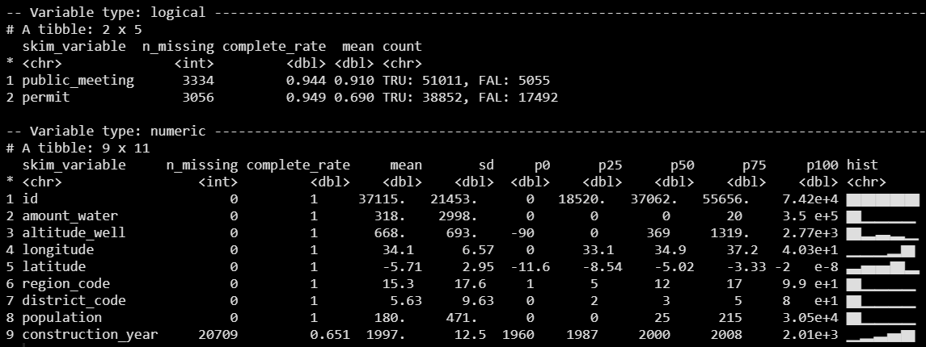

EDA – Logical and Numeric

Slide 7
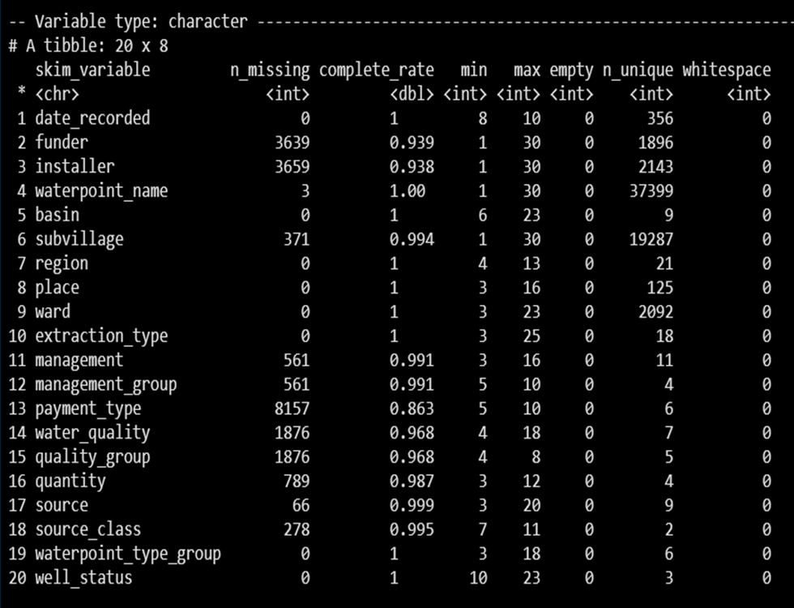
EDA – Character

Slide 8
Data Transformation and Feature Engineering using recipes package
update_role(id, new_role = "id") # specifying the role of “id” variable as it high cardinality variable and not a significant predictor
step_unknown(all_nominal_predictors()) # assign a missing value in a factor level to "unknown"
step_novel(all_nominal(), -all_outcomes()) # convert all nominal variables except outcome to factors and takes care of other issues related to categorical variables
step_other(all_nominal_predictors(), threshold = 0.02, other = 'non_frequent’) # collapse values with less than 2 % occurrence into a “non_frequent" category.
step_dummy(quantity, one_hot = T, -has_role("id")) # one hot encoding of quantity variable
step_zv(all_predictors()) #removes any numeric variables that have zero variance
step_BoxCox(all_numeric_predictors()) #rescale positive variables to be more similar to a normal distribution
step_normalize(all_numeric_predictors(), -latitude, -longitude) # apply normalization on all numeric predictors except latitude and longitude

Slide 9
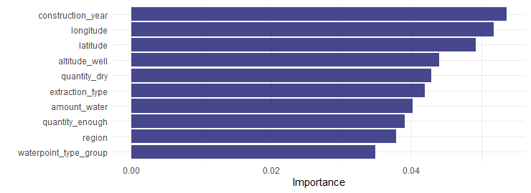
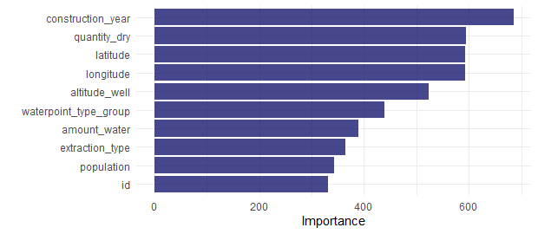
Feature Extraction using VIP Package
What are the most important variables for predicting well_status?
Using the random forest algorithm with importance set to permutation and impurity in order to extract features with highest importance.
importance = "permutation"
importance = "impurity"
Both importance functions have found construction_year to have high predictive value, combining the variables from both functions returns the variables shown below and will serve as the variables to proceed with modeling.
The final formula to be used for modeling:
(formula = well_status ~ altitude_well + longitude + latitude + construction_year + quantity + population)

Slide 10
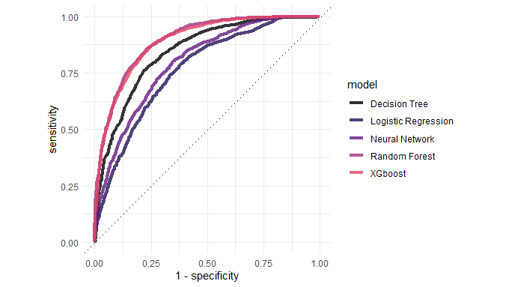
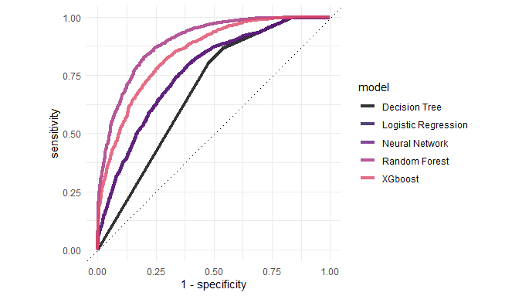
Model comparison and evaluation
roc_auc plots comparing multiple models - with and without Hyperparameter Tuning
roc_auc plot comparing tuned models
roc_auc plot comparing untuned models
Metrics | Logistic Regression | Decision Tree | Random Forest | Xgboost | Neural Network
Tuned Accuracy | 0.731 | 0.792 | 0.832 | 0.833 | 0.754
Tuned roc_auc | 0.766 | 0.845 | 0.895 | 0.890 | 0.797
Untuned Accuracy | 0.730 | 0.727 | 0.832 | 0.787 | 0.750
Untuned roc_auc | 0.765 | 0.685 | 0.893 | 0.846 | 0.788

Slide 11
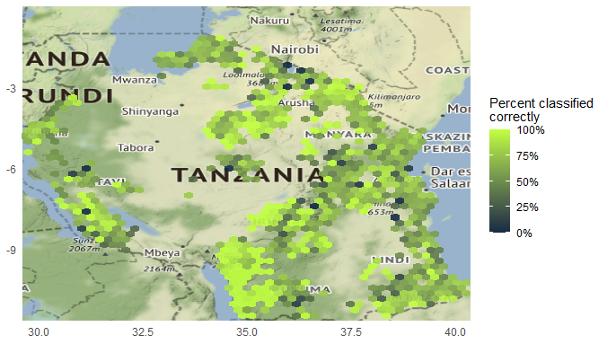
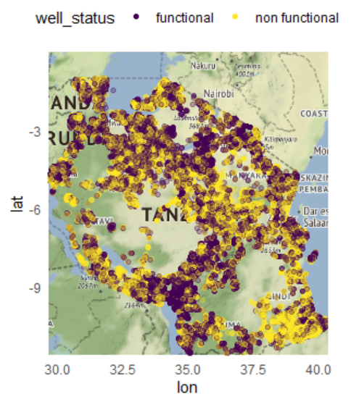
Exploring the data with ggmap package
Above – Predictions from 5 fold cross validated XGboost Model with tuned Hyperparameters.
Right – Original dataset showing well_status = “functional” and “non functional” plotted on the Tanzania Map.

Slide 12
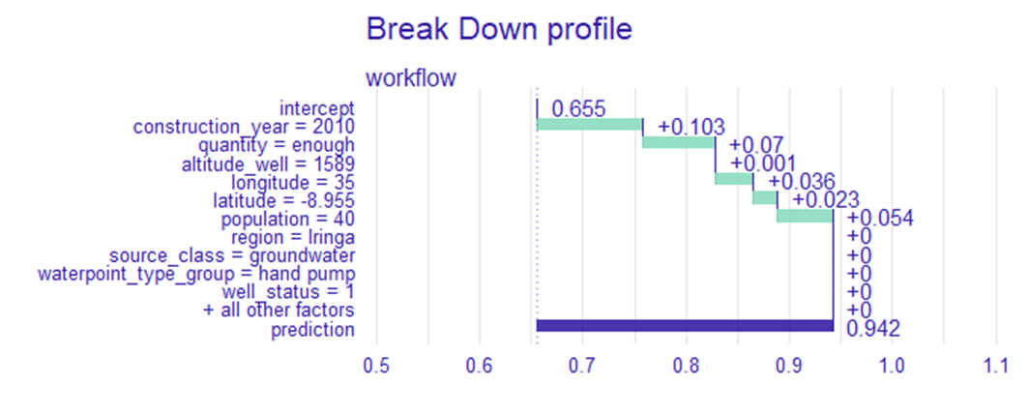
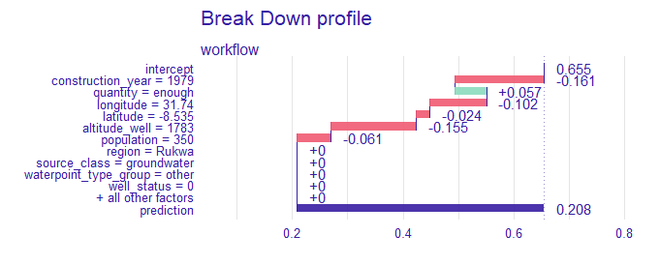
Model Interpretability – Instance level findings
Break-down plot of random forest model showing instance level variable explainability and influence on outcome.
Instance – row 9,999
Prediction – 94.2% probability that the well is functional
Construction_year – 2010 increases the probability that the well is functional by 10.3%
Quantity = enough - increases the probability that the well is functional by 7%
*No negative influence of variables is noted in this instance
Instance – row 21,999
Prediction – 20.8% probability that the well is functional
Construction_year – 1979 decreases the probability that the well is functional by 16.1%
Quantity = enough - increases the probability that the well is functional by 5.7%
*Only one variable having positive influence is noted in this instance

Slide 13
Conclusion
Best Performing Algorithms –
Random forest and XGboost models perform the best.
Random forest has the best out of the box performance.
Hyperparameter tuning greatly improves the performance of decision tree and XGboost models
Variables –
construction_year, location(longitude and latitude) and quantity have the highest predictive power
Feature Engineering can reveal important features that may not have been considered to have high predictive power initially as in the case of quantity
It is import to bin variables with high number of levels
Data preprocessing is important in order to avoid Garbage in Garbage Out
Some variables such as source, source_class seem important at first glance but weren’t found to be important during feature extraction

Slide 14
Learning Points
Using multiple models to compare results is important in finding the best results
High quality visualizations make it easy to engage stakeholders
Exploratory Data Analysis is a key part of learning about the data
Tree based models may perform better than Deep Learning models on tabular data
It is important to split the dataset for training and testing by generating stratified samples by the target variable to avoid class imbalance
It is important to use cross-validation and bootstrap resampling to train robust models
It needs to be ensured that all variables are encoded correctly

Slide 15
References
Tanzania Water Competition: https://www.drivendata.org/competitions/7/pump-it-up-data-mining-the-water-table/
Julia Silge:
https://juliasilge.com/blog/water-sources/
https://juliasilge.com/blog/xgboost-tune-volleyball/
3. yuzaR-Blog: Zablotski (2021, Jan. 9). yuzaR-Blog: Deep Exploratory Data Analysis (EDA) in R. Retrieved from https://yuzar-blog.netlify.app/posts/2021-01-09-exploratory-data-analysis-and-beyond-in-r-in-progress/
4. Explanatory Model Analysis: https://ema.drwhy.ai/breakDown.html
5. Tidymodels: https://www.tidymodels.org/

